Slide 1

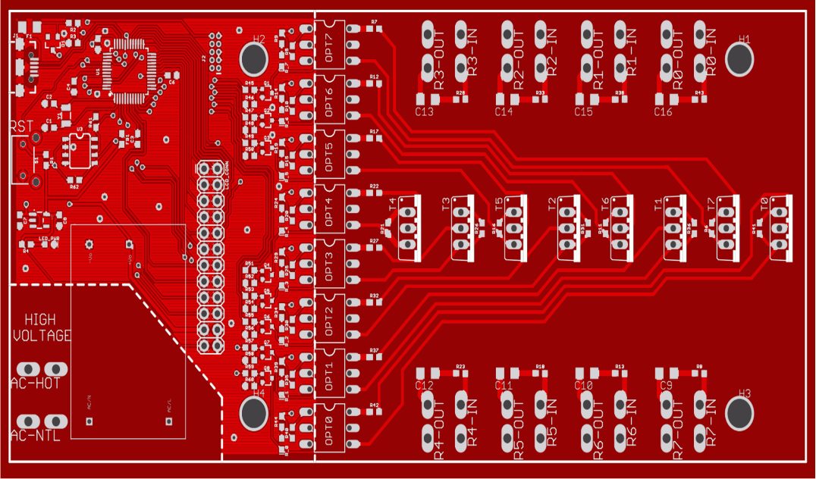
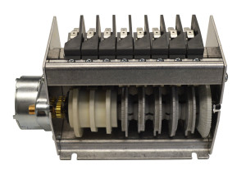
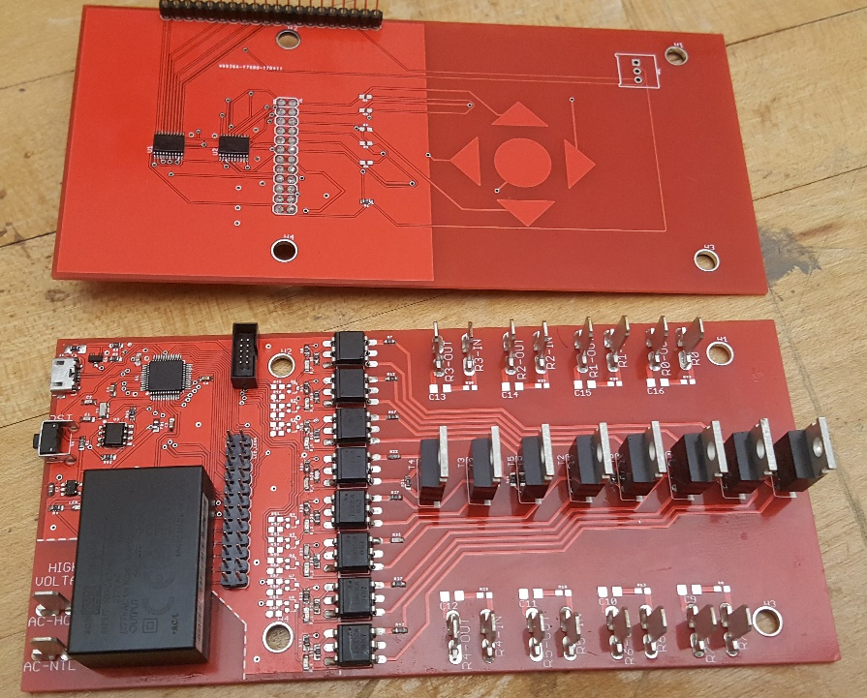
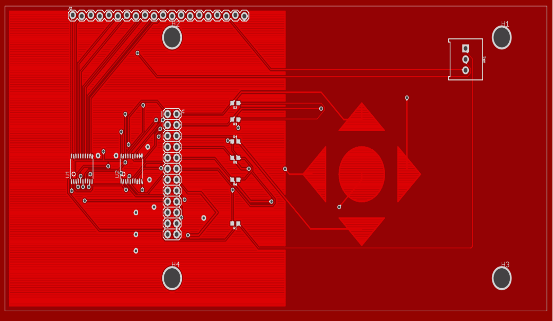

Solid-State Timing Device
ECE Team 1721: Jaileen Algarin, Robert Endrizzi, Nicole Hershman, Patrick Meres, Dr. Rajeev Bansal
ME Team 9: Patrick Dunham, Joshua Reinert, Dr. Thanh Nguyen
Sponsor: Andrew Smith
Objective
Solid-State Design Overview
The goal of the design project was to design a solid-state version of a standard electromechanical cycle timer. The new design was required to match the physical footprint of the old device, and meet or exceed all operation parameters of the old device.
Microcontroller
Controls on/off timing of relays, and allows for reprogramming of timing sequence.
Relay
Controls flow of power to connected AC devices (e.g. pumps, motors, heating elements).
Power Supply
Converts mains voltage (120 – 240 VAC) to logic voltages (5 VDC, 3.3 VDC) to power device.
User Interface
Enclosure
Serves to mount the device, as well as protect the device from short circuits.
Allows the end user to quickly change the device timing sequence in the field.
Figure 1: Original C10B 8-Cam Cycle Timer
Figure 2: Redesigned Solid-State Cycle Timer
Solid-State Timer Operation
Figure 4: Solid-State Timer Block Diagram
Figure 5: Solid-State Timer Component Description
Figure 6: Solid-State Timer PCB Breakdown
Idle Mode
Run Mode
Reset Mode
Program Mode
Timer is off – timing sequence position is saved.
Timer executes timing sequence, turning on/off devices
Timer prepares for next run, resetting saved position
Timer allows changes to timing sequence, does not run
Specification Comparison
Cycle Length
60 – 120 Seconds, Adjustable
Accuracy
_{±0.25 s}
_{±0.02 s}
8 Loads (15 A Max)
8 Loads (10 A Max)
Cost
Lifetime
$50, including labor
$40, not including labor
Size
100,000 cycles minimum
1,000,000 cycles (predicted)
Power
6.00” L x 2.88” W x 3.30” H
6.02” L x 2.82” W x 3.5” H
Const. 3 Watts
Between 0.25 W and 0.5 W
No tools required to reprogram
Timer Design
Old – Mechanical
New – Solid-State
Ease of Use
Requires special tool to reprogram
Outputs
Figure 3: Solid-State Timer State Machine
Conclusion
Transitioning the cycle timer design to a fully electronic model allows for greater lifetime, lower power consumption, improved ease of use, and greater expandability. This design is easily adaptable to incorporate sensor feedback, allowing the timing sequence to be modified on-the-fly with real-time data. Applications include commercial dishwashers, HVAC systems, and sterilization equipment.
Figure 7: Cycle Timer Feature Comparison

